Slide 1


Analyzing the Impact of Academic Pressure on Mental Health
This project examines the relationship between academic pressure and mental health among university students. Using data analysis, we aim to identify trends and provide insights to improve student well-being.
by Aminur Rahman and Farhana Tabassum
.

Slide 2

Introduction
University students face significant mental health challenges due to academic demands, financial stress, and social pressures. This project uses data science to analyze these factors and their impact on student well-being.
Academic Demands
Balancing coursework, deadlines, and high expectations can lead to stress and anxiety.
Financial Stress
Tuition fees, living expenses, and limited financial aid contribute to students' worries.
Social Pressures
Building relationships, fitting in, and managing social expectations can impact mental health.

Slide 3

Objectives: Uncovering the Factors Impacting Student Well-being
1
Analyze the Relationship
2
Explore Additional Impacts
Investigate the link between academic pressure and mental health outcomes like depression, anxiety, and isolation among university students.
Examine the influence of factors such as financial concerns, social relationships, and stress relief activities on students' mental health.
3
Identify Demographic Patterns
4
Develop a Predictive Model
Determine how demographic factors, including gender, age, residential status, and degree level, intersect with mental health outcomes.
Create a model to estimate mental health risks based on students' academic and personal characteristics, informing targeted support services.

Slide 4

Data Description
Demographic
Academic
Mental Health
Gender, age, residential status.
Academic workload, CGPA, academic year.
Depression, anxiety, isolation levels.

Slide 5

Methodology: Data Collection & Preprocessing
Data will be collected through a student survey, including demographic information, academic factors, mental health outcomes, social and lifestyle factors, and personal factors.
1
Data Collection
Gather data through a comprehensive student survey covering various aspects of their lives.
2
Data Cleaning
Address missing data and ensure data consistency for accurate analysis.
3
Data Transformation
Convert categorical variables into numerical formats and create new features if needed.

Slide 6

Methodology: Analysis & Modeling
We will conduct exploratory data analysis (EDA) to visualize relationships between variables. Statistical analysis will assess correlations and significant differences. Predictive modeling will estimate mental health risks.
4
Exploratory Data Analysis
Visualize data using graphs and charts to understand patterns and relationships.
5
Statistical Analysis
Perform correlation analysis and hypothesis testing to evaluate relationships and differences.
6
Predictive Modeling
Build and evaluate a model to predict mental health risks based on identified factors.

Slide 7
Target Audience: Reaching Stakeholders Invested in Student Well-being
University Personnel
Academic Community
Students and Beyond
Administrators and mental health counselors can utilize the findings to understand key factors affecting students and design targeted support programs.
Researchers and educators can incorporate the insights into academic discussions on the role of academic pressure and social factors in mental health outcomes.
Students can gain awareness of mental health challenges and learn practical strategies for managing stress. Policymakers and advocacy organizations can use the findings to advocate for policies promoting mental well-being in educational institutions.

Slide 8

Impact and Benefits to Society: Fostering a Healthier Academic Environment
1
Improved Student Well-Being
Reduce the incidence of depression, anxiety, and isolation among students, leading to a healthier academic environment.
2
Data-Driven Policy Formation
Provide universities and policymakers with data-driven insights to create evidence-based policies that address mental health challenges specific to students' academic and social environments.
3
Increased Awareness
Raise awareness among students, educators, and administrators about the importance of addressing mental health proactively, rather than reactively.

Slide 9

Expected Outcomes: Tangible Results for a More Supportive Campus
Key Factor Identification
Demographic Insights
Identify key factors, such as academic pressure, financial concerns, and social relationships, that are most strongly associated with mental health challenges among university students.
Gain insights into how mental health outcomes differ by demographic groups, such as gender and residential status.
Predictive Model Development
Data-Driven Recommendations
Develop a predictive model that can estimate the likelihood of depression, anxiety, and isolation based on academic and personal characteristics, providing a tool for early mental health interventions.
Provide data-driven recommendations for universities to implement targeted mental health programs that address the specific challenges faced by students.

Slide 10
Budget and Resources
The project will utilize primarily free and open-source tools for data analysis, visualization, and reporting. The estimated budget is 0-5,000 BDT, depending on the need for additional cloud services or research materials.
Budget
Resources
Covers computational resources, research costs, and report materials. Estimated at 0-5,000 BDT.
Includes human resources, provided datasets, software like Python, and a time commitment of 4-5 weeks.

Slide 11

Impact and Benefits
This project aims to improve student well-being, inform data-driven policies, and increase awareness about mental health. It will provide actionable solutions for students and contribute to a more supportive academic environment.
1
Improved Well-being
Reduce the occurrence of depression, anxiety, and isolation among students.
2
Data-Driven Policies
Guide universities in creating evidence-based policies to address mental health challenges.
3
Increased Awareness
Promote proactive mental health support and emphasize its importance in academic settings.

Slide 12
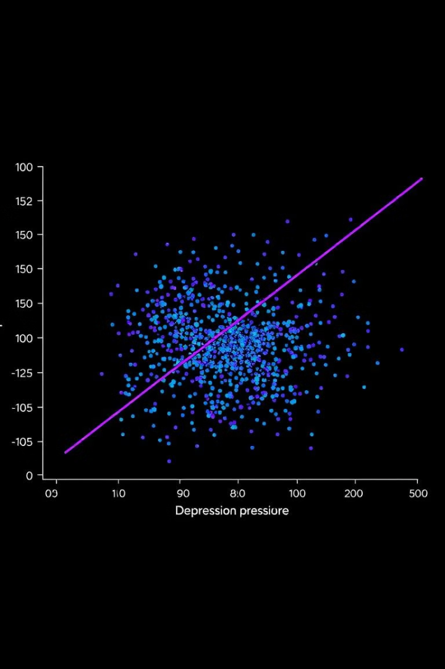
Predictive Modeling and Results
A logistic regression model, with 75% accuracy, identified academic workload, financial stress, and sleep as strong predictors of depression in students.

Slide 13




Recommendations
Counseling Services
Increase access to counseling and mental health support, particularly during stressful periods.
Financial Counseling
Offer financial management advice to alleviate stress related to financial pressures.
Promote Activities
Encourage social and physical activities to reduce stress and enhance mental well-being.

Slide 14

Discussion
Findings emphasize the need to address academic pressure, financial stress, and social factors to improve student mental health. Both academic and lifestyle factors contribute to well-being, requiring targeted interventions.

Slide 15




Conclusion
This project addresses the pressing issue of student mental health in higher education. By analyzing academic pressure and other contributing factors, we aim to provide actionable solutions for universities to create a more supportive and healthier learning environment for all students.
Mental Health
Prioritizing student well-being and addressing mental health challenges.
Academic Success
Creating a supportive environment for students to thrive academically.
Data-Driven Solutions
Using data analysis to inform effective interventions and support systems.

